Slide 1
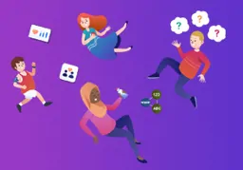
Emotional Health and Wellbeing
Mental health is as important to a child's safety and wellbeing as their physical health. It can impact on all aspects of their life, including their educational attainment, relationships and physical wellbeing. (NSPCC)

Slide 2
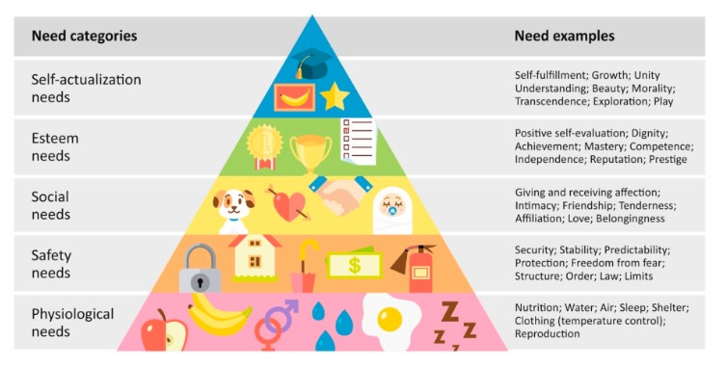
Maslow's Hierarchy of Needs

Slide 3
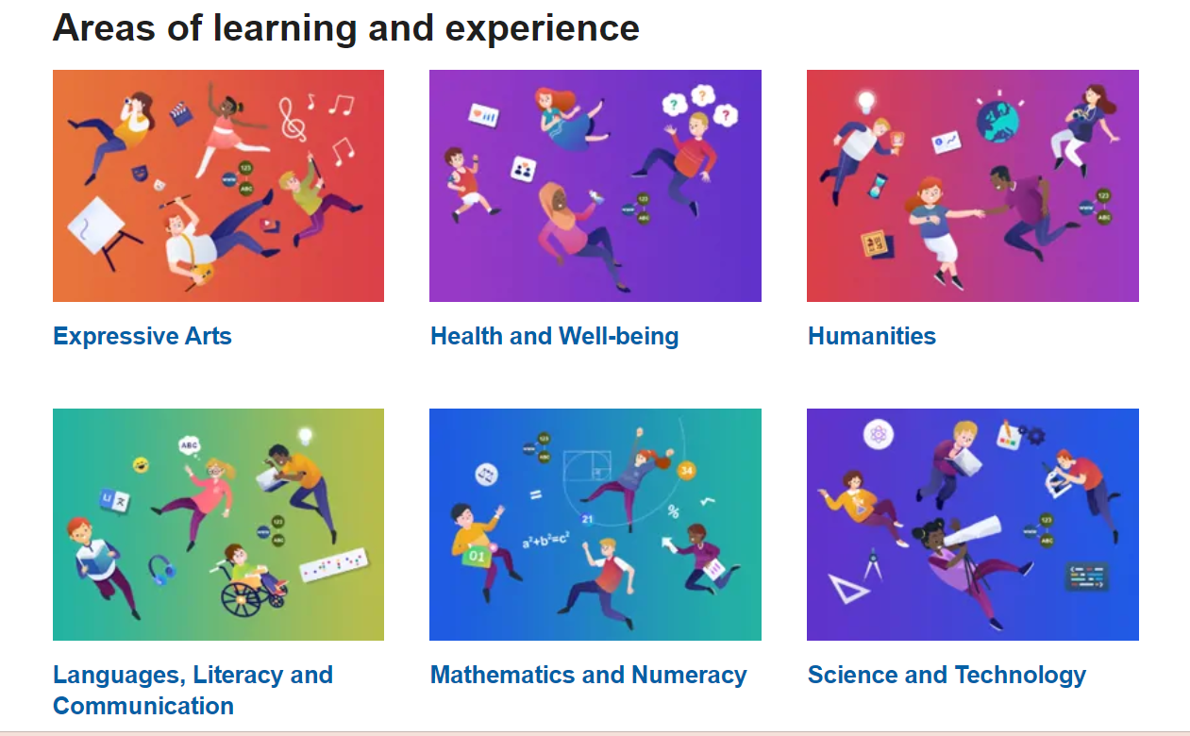
The 6 AOLEs Curriculum for Wales

Slide 4
Health and Wellbeing AOLE
5 STATEMENTS OF WHAT MATTERS
Developing physical health and well-being has lifelong benefits.
How we process and respond to our experiences affects our mental health and emotional well-being.
Our decision-making impacts on the quality of our lives and the lives of others.
How we engage with social influences shapes who we
are and affects our health and well-being.
Healthy relationships are fundamental to our well-being.

Slide 5
Developing physical health and well-being has lifelong benefits.
Nutrition
Healthy Lifestyle Choices
Exercise
Sleep and Rest

Slide 6
How we process and respond to our experiences affects our mental health and emotional well-being.
Resilience
Empathy and Reflection
Self Regulation
Thoughts and feelings
Communication

Slide 7
Our decision-making impacts on the quality of our lives and the lives of others.
Individual and group decisions
Informed decisions
Is it safe or unsafe?
Recognise the impact now and in the future

Slide 8
How we engage with social influences shapes who we are and affects our health and well-being.
Social Media
Attitudes and values
Rules, norms and beliefs
Care and respect

Slide 9
Healthy relationships are fundamental to our well-being.
Maintain healthy relationships
Communicate needs and feelings
Resolve conflict
Know about rights UNCRC

Slide 10
United Nations Convention on the Rights of the Child
ARTICLE 12 Children have the right to give their opinions freely on issues that affect them. Adults should listen and take children seriously. | ARTICLE 13 Children have the right to share freely with others what they learn, think and feel, by talking, drawing, writing or in any other way unless it harms other people. | ARTICLE 14 (freedom of thought, belief and religion) Every child has the right to think and believe what they choose and also to practise their religion, as long as they are not stopping other people from enjoying their rights.
ARTICLE 24 (health and health services) Every child has the right to the best possible health. Governments must provide ……….and education on health and well-being so that children can stay healthy. | ARTICLE 28 (right to education) Every child has the right to an education. Discipline in schools must respect children’s dignity and their rights. ARTICLE 29 (goals of education) Education must develop every child’s personality, talents and abilities to the full. It must encourage the child’s respect for human rights, as well as respect for their parents, their own and other cultures, and the environment. | ARTICLE 31 (leisure, play and culture) Every child has the right to relax, play and take part in a wide range of cultural and artistic activities.

Slide 11


Slide 12
Ending physical punishment of children | GOV.WALES

Slide 13
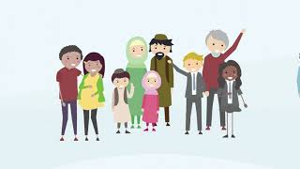
https://www.gov.wales/parenting-give-it-time/support
https://www.cardifffamilies.co.uk/

Slide 14
What Do We Do In School?
We have a Relational Approach where children know that there are trusted adults they can talk to.
THRIVE -We teach children about their brains, how to manage big feelings and we validate their feelings whilst helping them to make good choices during ‘time in’ sessions.
FLOURISH for Year 6 children-a programme designed to improve mental & emotional wellbeing, self-esteem and resilience.
Restorative approach and Conflict Resolution- Children learn how to manage conflict in healthy ways and they learn what they need to do if someone has been hurt or upset-we use the Wheel of Choices.
UNCRC-Children learn about their rights as ‘rights holders’ and about the role of adults as ‘duty bearers.’
RSE Code-Children learn about healthy and unhealthy relationships, about consent and who they can talk to if they need help.
SPECTRUM PROJECT- teaching pupils about healthy relationships.
St Monica’s University electives.

Slide 15
What Can You Do At Home? Whole School Approach
Let your child know that you are there for them if they want to talk about something-children often want to talk at bedtime or when it’s quiet.
Name and validate emotions for your child-give them the language to talk about their wellbeing.
Be their co-regulator to help them manage ‘big feelings.’ This will help them develop their own strategies for self-regulation.
Give them time to relax, spend time in nature, engage in creative activities, exercise and eat a balanced diet.
Make sure they have a balance of screen time and time away from screens.
Ensure they are getting enough sleep.
Help them manage conflict and disagreements with siblings or friends.
Contact https://www.cardifffamilies.co.uk/ Family Support https://www.cardifffamilies.co.uk/cardiff-parenting-0-18/
Look at our audiobooks and podcast list
Come along to Family Thrive in June.

Slide 16
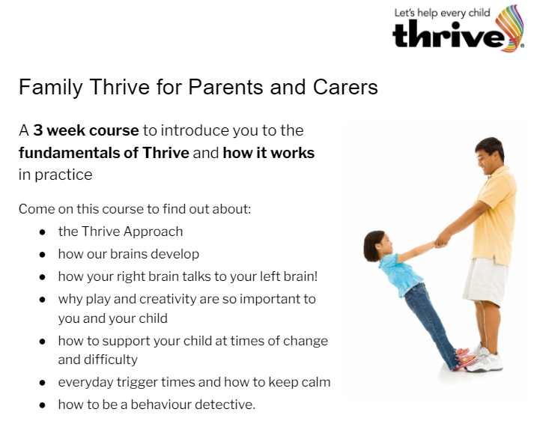
If you’d like to know more……

