Slide 1
Safer Internet Use
for Parents
Wednesday 29th January 2024

Slide 2

We have a duty to keep the children and young people in our care safe.
Safer Internet Day

Slide 3
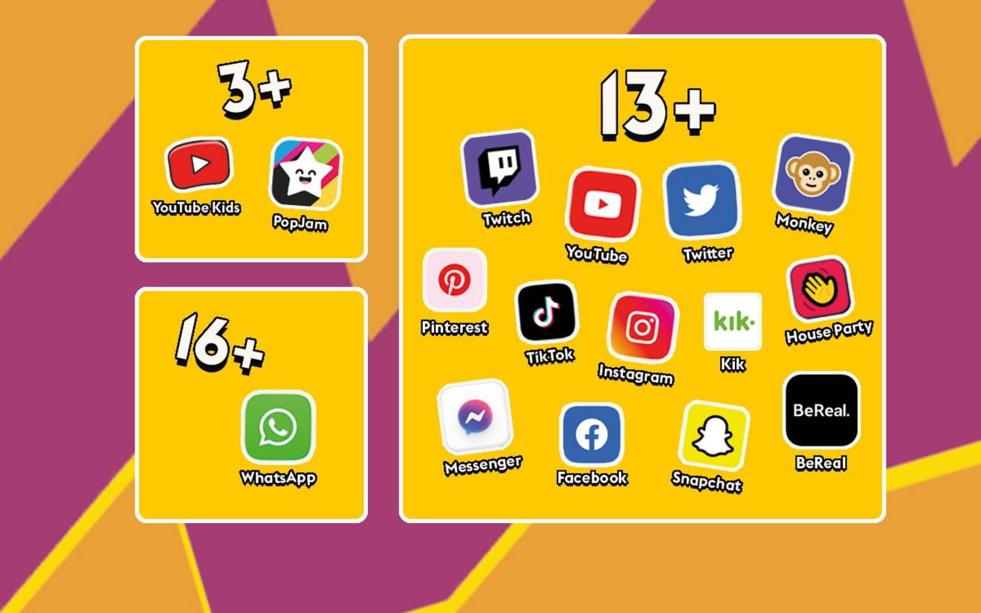
Age Appropriate Apps

Slide 4
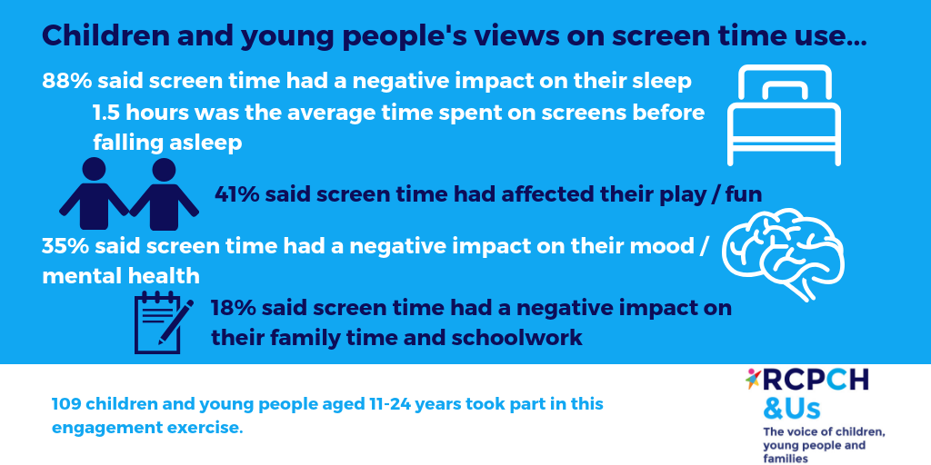
Screen Time

Slide 5
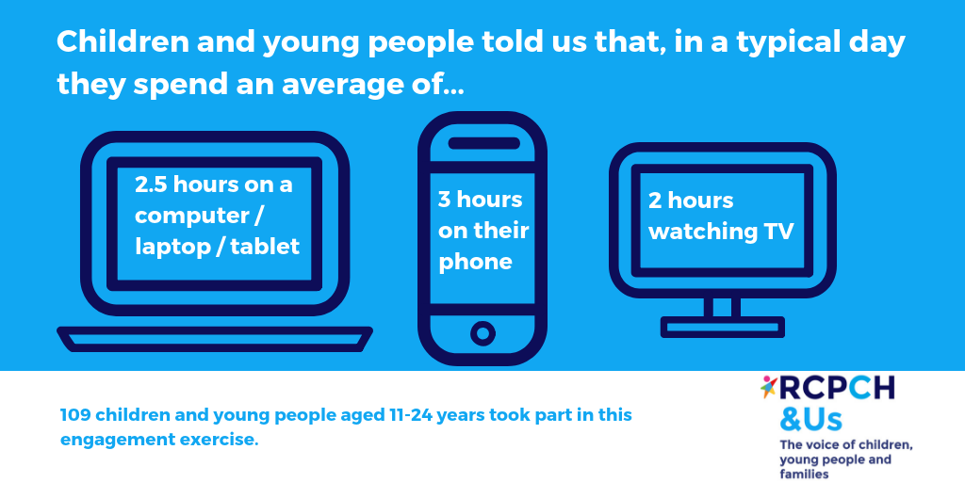

Slide 6
Our primary recommendation is that families should negotiate screen time limits with their children based upon the needs of an individual child, the ways in which screens are used and the degree to which use of screens appears to displace (or not) physical and social activities and sleep.
Screen Time Fact Sheet

Slide 7
Mobile Phones
1. Set boundaries
It’s important to set boundaries and limits with your kids. Talk to them about the boundaries themselves, and your reasons for setting them.
2. Utilise parental controls & engage with your child’s phone usage
Parental controls allow you to see exactly what sites and apps your child is accessing on their smartphone, tablet or computer. It also lets you see how long they are spending on these devices.
Parent Controls NSPCC

Slide 8
3. Teach your children phone security
By teaching your child a few security measures now, you will help them keep their devices secure in the long run. Examples include:
Don’t connect to public wi-fi as that may give hackers access to your child’s phone and information.
Don’t share passwords with friends or strangers.
Don’t overshare online – once a photo or video is out there, it can’t be taken back.
Keep your phone close in your bag or on-hand rather than leaving it in public places where it can be stolen.
Password protect the phone so that if it is stolen, personal photos or messages can’t be easily accessed.
Advice for Children

Slide 9
Cyber Bullying
Cyberbullying is bullying online and any form of anti-social behaviour over the internet or via a mobile device. It is an attack or abuse, using technology, which is intended to cause another person harm, distress or personal loss.

Slide 10
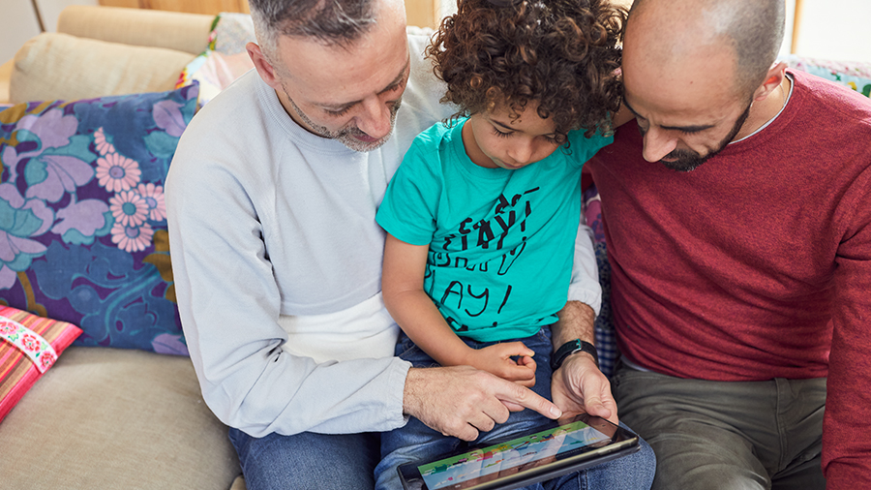
Starting the conversation
Talking regularly with your child can help keep them safe online. Making it part of daily conversation, like you would about their day at school, will help your child feel relaxed.
It also means when they do have any worries, they’re more likely to come and speak to you.
But it’s easy to become overwhelmed with the different technology, the language that children use, the huge number of games and apps which are available and the potential risks.

Slide 11
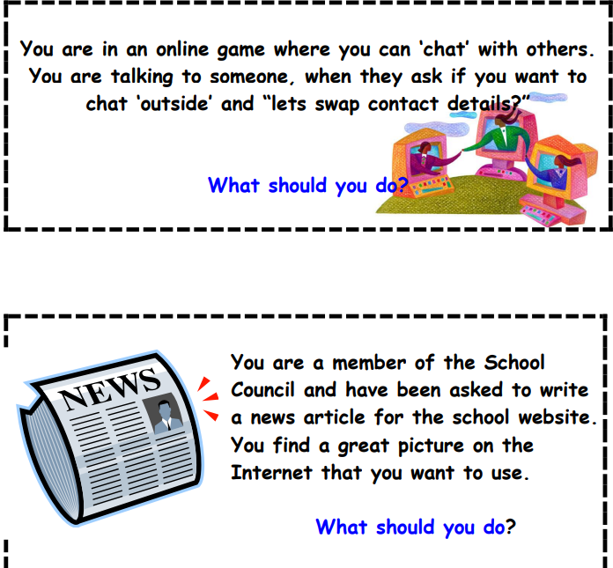
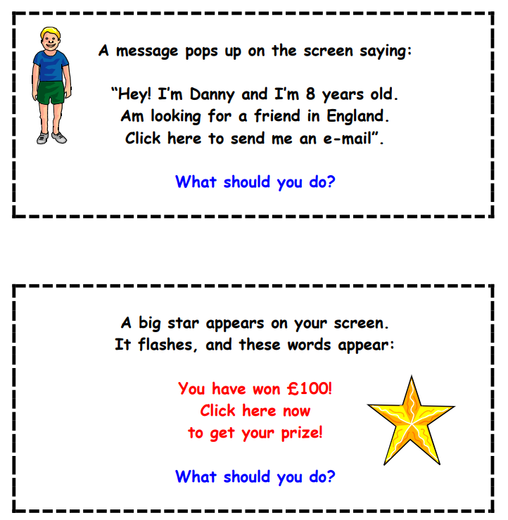
Scenarios and Quiz

Slide 12


