Slide 1

Smart Phones in Schools
Notes:
Smartphone Free Childhood
In recent months there has been growing awareness of the harmful effects of smartphones on young people's well-being. New research has received extensive media coverage and thousands of parents have joined national campaigns such as Smartphone Free Childhood, in a bid to delay giving smartphones to their children.

Slide 2
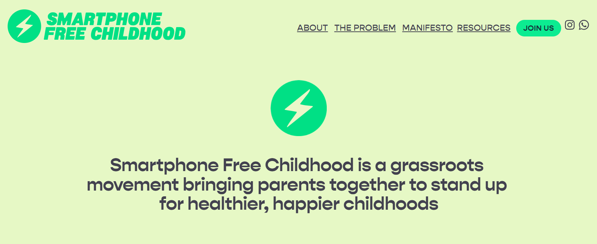
Notes:
A number of parents and carers from St Monica’s have joined the Smartphone Free Childhood WhatsApp group and have signed the Smartphone Free Childhood Parent Pledge to delay giving their child(ren) a smartphone until at least the end of Year 9.
The problem
When we first started giving smartphones to children, we didn’t understand their impact. Now, there is a growing body of evidence linking smartphone use with an array of harms. Smartphones are linked closely with anxiety, depression and loneliness. They are a gateway to extreme content and unwanted communication. Research shows that smartphones affect academic performance and many children show signs of behavioural addiction to their devices.

Slide 3

Notes:
Educational Research
https://www.youtube.com/watch?v=yVq4ARIlNVg

Slide 4
Smartphones are experience blockers, distracting children from engaging in the real world.
The average UK 12-year-old now spends 29 hours a week – equivalent to a part-time job – on their smartphone. This leaves little time for the real world activities and relationships that enable us to learn the essential life skills needed for the transition to adulthood.

Slide 5
It is not surprising that new research shows that the younger a child receives their first smartphone, the worse their mental health. And yet, the age children are getting their first smartphone is getting younger and younger. In the UK, a fifth of 3-4 year olds own their own device and 24% of 5-7 year-olds do.

Slide 6

Should we make
St Monica’s
smartphone free?
Notes:
Should we make St Monica’s a smartphone free school, and implement a new policy whereby smartphones are no longer allowed on school premises - should this also include them not being seen at drop off time and pick up time by adults???
The discussion is likely to be around the following points:
to better safeguard the learning environment;
ensure the welfare of all students;
uphold the ethos of our school community;
rules around smartphones might include confiscation of the phone with it being returned at the end of term; and
children having access to only simple phones (provided by parents) if they need to be contactable on their way to and from school
As always, if there are exceptional circumstances that require a child to bring a smartphone into school each day, for example if it is used as a medical device, the request would be carefully considered and parents will be informed of the outcome.

Slide 7

Should we make St Monica’s a smartphone free school?
Notes:
I absolutely understand the irony of asking this now… would you like to do our survey?
Here’s a QR code directly to it, it will also be texted out to parents, governors and staff later today.

